Slide 1

jBilling Integration
API

Slide 2
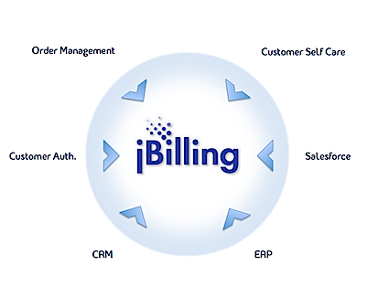
Why integrate?
Overview

Slide 3

Architecture
Uses spring remoting
One spring bean gets exposed as a remote service
This bean can either be soap, hessian/burlap or spring http invoker
Jbilling gui uses the api to do any crud actions.
Calls to/from jbilling

Slide 4
Useful Links
jBilling guide – integration chapter
http://{jbilling app}:{port}/jbilling/services

Slide 5
Configuration
Copy the jbilling.jar file to your classpath (if it’s not available create it with the grails jar command)
Copy the spring.jar, log4j.jar and commonslogging.jar if needed.
Copy the file jbilling-remote-beans.xml from the descriptors/spring folder to your application.
If you use hessian you will need the hessian.jar
If you use soap you will need the cxf.jar and some support libraries like xmlschema.jar, wsdl4j.jar, fastinfoset.jar and neethi.jar

Slide 6
Tips & Tools
Logs
The logs are your friends. Whenever you make a call to a method in the api you will see two entries in the logs: one before the call showing all the parameters sent, and one after the call showing the return value.
You can search for this string to find those entries: com.sapienter.jbilling.server.util.api.APILogger

Slide 7
Tips & Tools
WSTest
You should always remember the the wstest classes use the api directly, just in the like you should do it. So you can go to any of the wstest classes and just search among the existing test methods to see if the scneario you are looking for is already tested.

